Slide 1
VUEJS 入门
Eric Jin

Slide 2
Source
https://github.com/today/vue-exam

Slide 3
VUEJS
可扩展的数据绑定
将普通的 JS 对象作为 model
简洁明了的 API
组件化 UI 构建
配合别的库使用

Slide 4
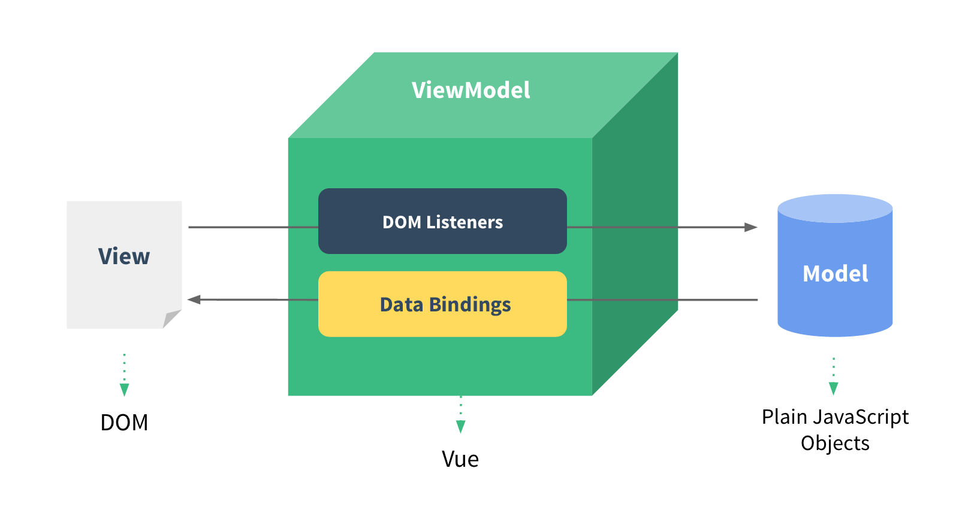
原理图

Slide 5
双向绑定
<input v-model="message" />
var vm = new Vue({
el: '#exam-1',
data: {
message: 'welcome to gdg xian'
}
});

Slide 6
列表
<li v-for="book in books"> {{ book.text }} </li>
var book_array=[
{ name: 'Learn JavaScript' },
{ name: 'Learn Vue.js' },
{ name: 'Build Something Awesome' }
];

Slide 7
过滤
<li v-for="book in books | filterBy param"> …
{{ message | capitalize }}

Slide 8
AJAX
$.ajax({
url: baseUrl + "/getBooks",
success: function(result){
//var tempObj = JSON.parse(result);
vm.books = result.data;
vm.message = result.message;
},
error:function(xhr,status,error){
vm.message = "系统出现错误";
console.log("error:" + error);
}
});

Slide 9
VUEJS 资源链接
http://cn.vuejs.org/guide/
http://vue-js.com/topic/56cfc64965cf1c422e006834

Slide 10
NodeJs 入门
Eric Jin

Slide 11
优点
Event-driven 事件驱动
Non-blocking 非堵塞
前后端通吃
快
社区活跃

Slide 12
当前版本
v4.4.3 LTS v5.10.1 Stable

Slide 13
console
var argv = process.argv,
who = (typeof argv[2] !== "undefined") ? argv[2] : "World";
console.log("Hello " + who + "!");

Slide 14
Web Server
var http = require("http");
http.createServer(function (req, res) {
res.setHeader("Access-Control-Allow-Origin", "*");
res.setHeader("Access-Control-Allow-Credentials", "true");
res.setHeader("Content-Type", "application/json");
res.write( "Hello world!" );
res.end();
}).listen(8000);
console.log("Server running at http://localhost:8000")

Slide 15
Deploy
https://www.heroku.com/
https://appengine.google.com/
VPS

Slide 16
NodeJS 资源链接
http://www.slideshare.net/q3boy/serverside-javascript-developement-nodejs-quick-tour-6212200
http://www.slideshare.net/josephj/nodejs-14734167
http://www.nodebeginner.org/index-zh-cn.html
https://github.com/alsotang/node-lessons
http://www.open-open.com/lib/view/open1432785701488.html

Slide 17
Source
https://github.com/today/vue-exam

Slide 18
Thank you.

